Slide 1
A trip down memory lane
Rolfe Bozier
16-Sep-2015
(or, all about core memory)

Slide 2
Agenda
What did core memory look like?
Its place in computing history
How did it work?
A proof-of-concept

Slide 3
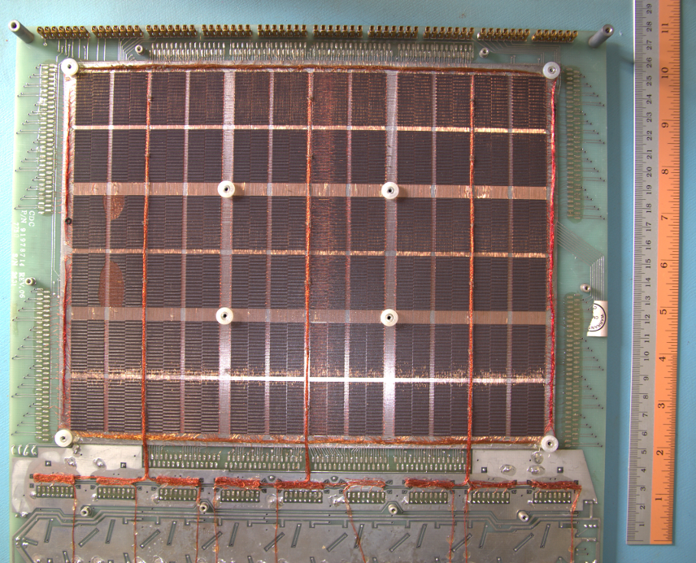
What does core memory look like?
1 bit stored in a small ferrite ring
This array:
16 kwords = 32 kbytes
294,912 cores
72 sub-blocks of 4 kbits
Separate driver board
Manufactured around 1977
General Automation Inc
҉
Notes:
Ferrite cores
Core array

Slide 4
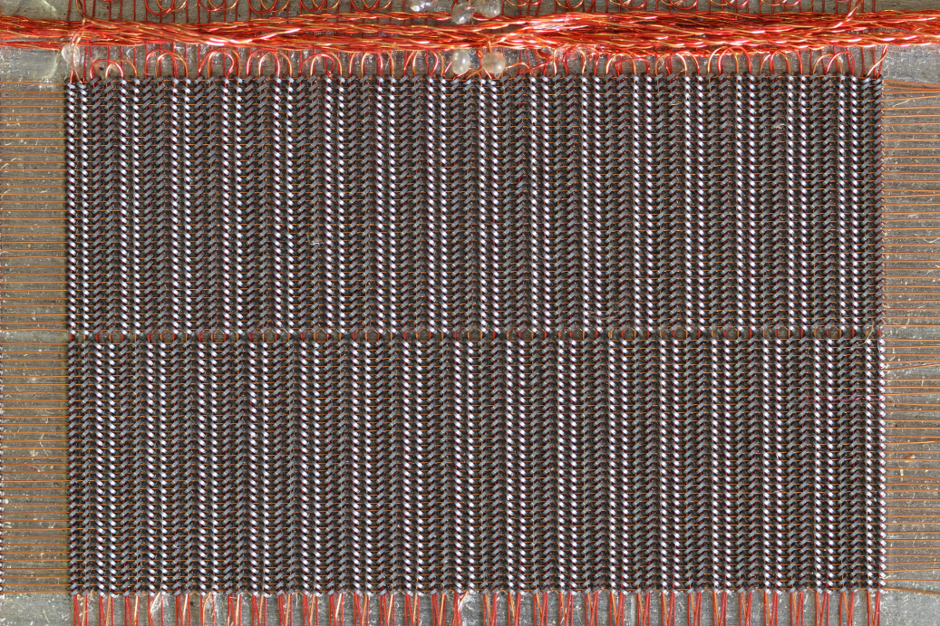
What does core memory look like?
Sub-block:

Slide 5
A brief history of computer memory
Before core memory
Relays
10-100s of bits
Rotating magnetic drums (1932 – 1960s)
Up to 100s kbits
Sequential access
Ancestor of floppy / hard disks
Williams tube (1947 - mid 1950s)
1-2 kbits
Random access
Delay lines (1947 – mid 1950s (and beyond))
1 kbit
Sequential access
After core memory
Semiconductor integrated circuits (early 1970s – now)
҉
Notes:
What was it replaced by? DRAM bank, flash cards

Slide 6
A brief history of computer memory
The lifetime of core memory, around 20 years

Slide 7
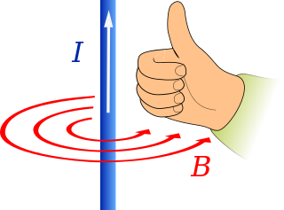
How did it work?
Ampere’s Law: A current generates a magnetic field encircling the wire
Place a ferromagnetic ring around the wire and the magnetic field can induce a permanent magnetic field in the ring
Clockwise = 0
Anti-clockwise = 1
So we can store 0 and 1 values in a ferrite ring, but how can we read the value back?

Slide 8
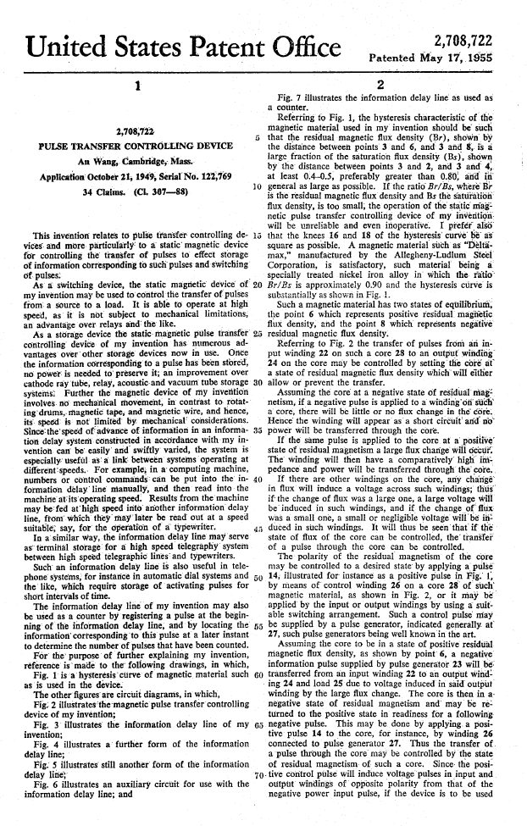
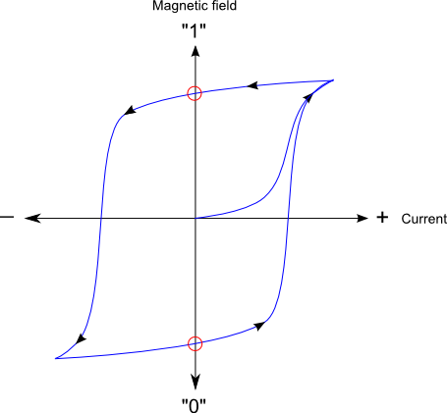
US 2,708,722 – An Wang
Magnetic field in the ring is not proportional to the current
Faraday’s Law: change in magnetic field induces a current in a nearby conductor
Add a second “sense” wire through the ring
Sense wire detects the flip as a pulse

Slide 9
US 2,708,722 – An Wang
Destructive read:
Write “0” value
If sense wire detects a flip,
The previous value was “1”
Rewrite the “1” value back
otherwise, do nothing
Wang created a 50-bit shift register form of memory using this technique
In 1955, Wang sold the patent to IBM for $500,000
That’s about $4.5M in today’s money…
Wang went on to form Wang Laboratories and revolutionise office computing

Slide 10
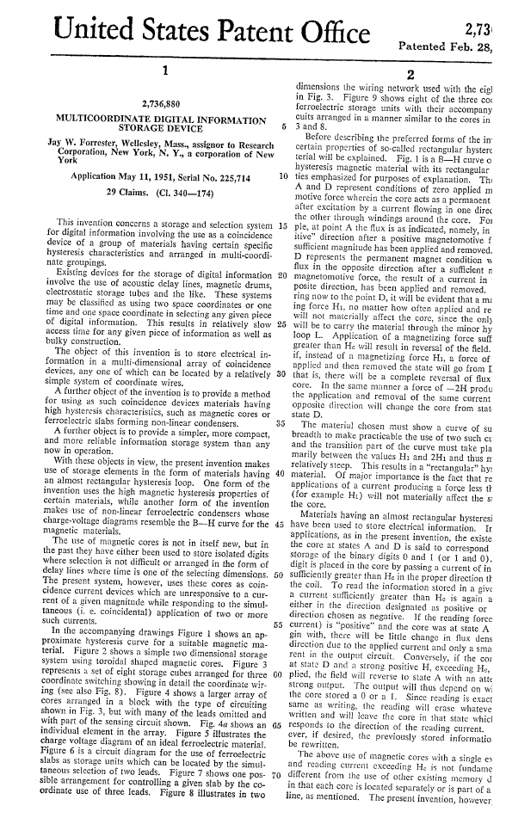
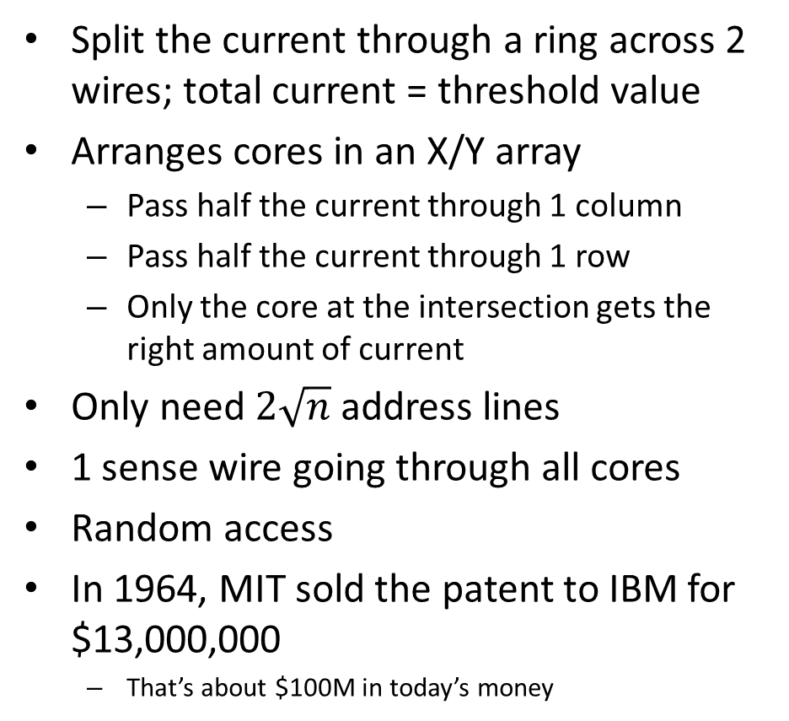
US 2,736,880 – Jay Forrester
Split the current through a ring across 2 wires; total current = threshold value
Arranges cores in an X/Y array
Pass half the current through 1 column
Pass half the current through 1 row
Only the core at the intersection gets the right amount of current
Only need $2\sqrt{n}$ address lines
1 sense wire going through all cores
Random access
In 1964, MIT sold the patent to IBM for $13,000,000
That’s about $100M in today’s money

Slide 11
Into the third dimension
You can’t keep making arrays bigger and bigger
Stacking them makes sense
Expand the address space by using extra bits to address each plane
Store each bit of a word in a separate plane
The inhibit wire was added to make this easier
Goes through each for in the plane (like the sense wire)
All planes share the same address lines
If you don’t want to write to a plane, put some reverse current through the inhibit line, so the net current is below the threshold
҉
Notes:
Show driver board

Slide 12
Performance
Performance
10s of kBytes per plane
Access time < 1μs (clock rate > 1MHz)
Random access
Non-volatile
Power-hungry
Assembly
Manual at first
Eventually jigs were created for semi-manual assembly
Shaking, vacuum tables
Wires threaded with special needles
“Ferrite Core Planes and Arrays: IBM’s Manufacturing Evolution”
http://ibm-1401.info/IBMCoreArraysIEEEMagnetics1969.pdf

Slide 13
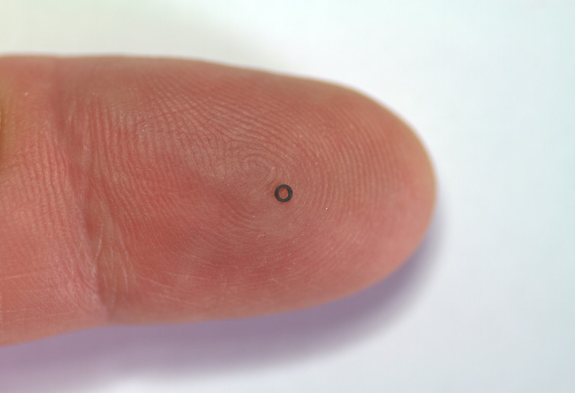
Proof-of-concept
You can buy ferrite cores on eBay:

Slide 14
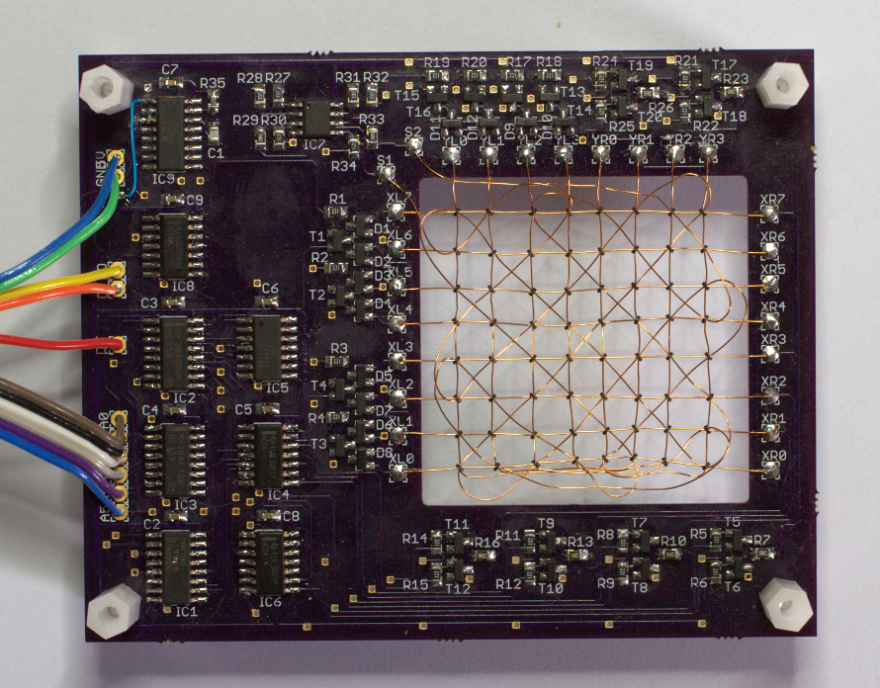
Proof-of-concept
An 8 byte memory board:
҉
Notes:
Memory board

Slide 15
Proof-of-concept
Detecting the sense line pulse:

Slide 16
Questions?
?

